Slide 1
Maryland NextGen Testbank: Training to Use Mini Reviews

Slide 2
About Mini Reviews
Mini Reviews are PowerPoint sessions with a combination of case studies and standalone items from the Maryland Next Gen Testbank
All sessions have:
Session instructions
Links questions in Qualtrics
Question answers
Rationales
Scoring details
Supplemental handouts
Faculty summaries
Student work sheets

Slide 3
Reviews Available
Comprehensive Mini Review
2.5-3 hours
Pediatrics Mini Review
2 hours
Maternal-newborn Mini Review
2 hours
Fundamentals Mini Review
2 hours
Mental Health Mini Review
2 hours
Medical- surgical Mini Review
4-6 hours

Slide 4
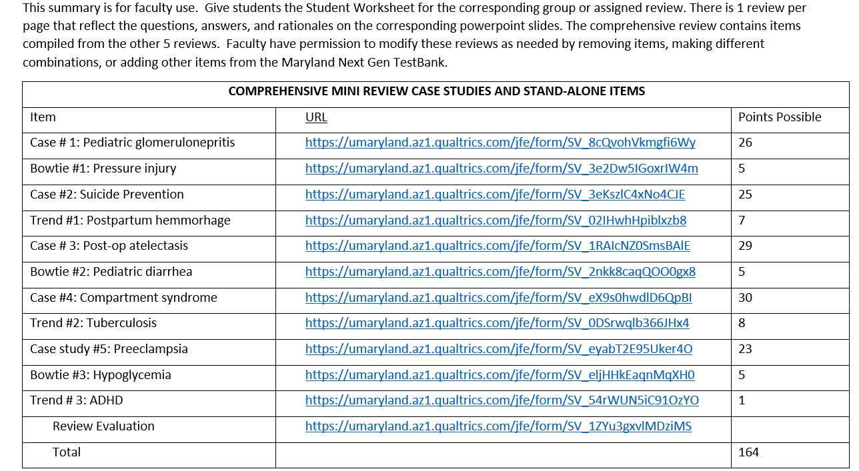
Faculty Summary

Slide 5
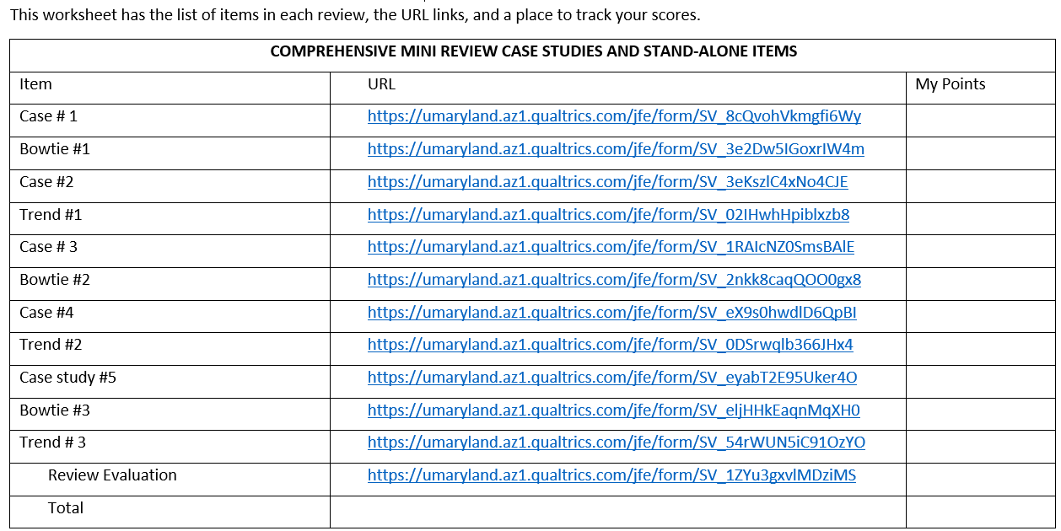
Student Work Sheet
Test
All 6 worksheets are on single pages in one word document.
Edit the document to reflect only the reviews you are using or want students to completet

Slide 6
About The NextGen NCLEX
Starting April 1, 2023, graduates will take an updated version of the National Council Licensure Exam referred to as Next Generation NCLEX.
Next Generation NCLEX (NGN) will continue to test a candidate’s ability to provide safe client care while incorporating new methods to better test clinical judgment.
The testing methods will include using new item response types in clinical judgment case studies and stand-alone questions to test the NCSBN Clinical Judgment Measurement Model(NCJMM) (https://www.ncsbn.org/exams/next-generation-nclex/NGN+Resources/clinical-judgment-measurement-model.page)
Ideally meant to be instructor lead, but could be used independently by students
This could be used by December graduates who fail NCLEX on 1st try and need to retake on NGN.

Slide 7
The Five New Item Response Types
Extended multiple response items with increased answer options.
Drag-and-drop items that involve moving options to placeholders.
Drop-down items where candidates select the missing words from sentences, paragraphs, or tables.
Highlight items that require candidates to identify parts of the medical record to answer questions.
Matrix/grid items that involve completing tables of information.

Slide 8
Case Studies
Unfolding case studies use approved NGN item types to answer questions about evolving real-world nursing scenarios.
Case studies present 6 linked questions to test the 6 steps of the NCJMM in order:
Recognize cues
Analyze cues
Prioritize hypotheses
Generate solutions
Take action
Evaluate outcomes
Candidates should expect to complete 3 to 5 case studies in a minimum length 85 question NCLEX exam.

Slide 9
Stand-alone Item Types
Stand-alone (single) items test either client needs or clinical judgment
Client needs items test knowledge of the 8 client needs using traditional or new item types.
Clinical judgment items present information in a clinical scenario specifically targeting one or more NCJMM clinical judgment step.
There are 2 unique types of clinical judgment stand-alone items:
Bow-tie
Trend
Clinical judgment stand-alone items make up approximately 10% of stand-alone items.

Slide 10
Stand-alone Item: Bowtie
A bowtie is a drag-and-drop response item variation.
After reading a clinical scenario, candidates move response options (tokens) to placeholders (targets).
On NCLEX the placeholders are arranged in the shape of a bowtie.
Candidates must select:
1 condition the client is most likely experiencing from 4 options.
2 actions to take to address the condition from 5 options.
2 parameters to monitor the client’s progress from 5 options.

Slide 11
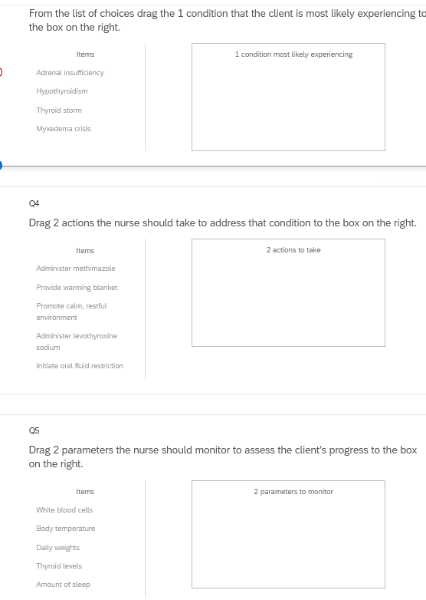
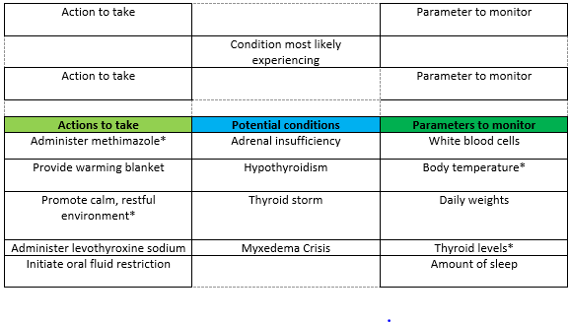
Bowties in Qualtrics
Bowties in Qualtrics are 3 drop and drag question- but they don’t make a “bowtie” shape.

Slide 12
Stand-alone Item: Trends
Trend items require the candidate to make clinical judgments based on client data presented at different time points.
Trend items may address one or more clinical judgment steps but do not follow the six-item sequence like case studies do.
Trend items can feature any item response type except bowtie.

Slide 13
About This Review
Your instructor will provide a QR code or link to answer a series of case studies, bowtie items and trends across a lifespan
While questions throughout the test bank use all 5 new item response, not all specific variations that might be used on NCLEX are not included such as drop-down items formatted as a table.
Information needed to answer questions will be displayed in a medical record, but the medical record will display differently on the actual NCLEX.
To see how items will exactly appear on NCLEX see tutorials at https://nclex.com/next-generation-nclex.page

Slide 14
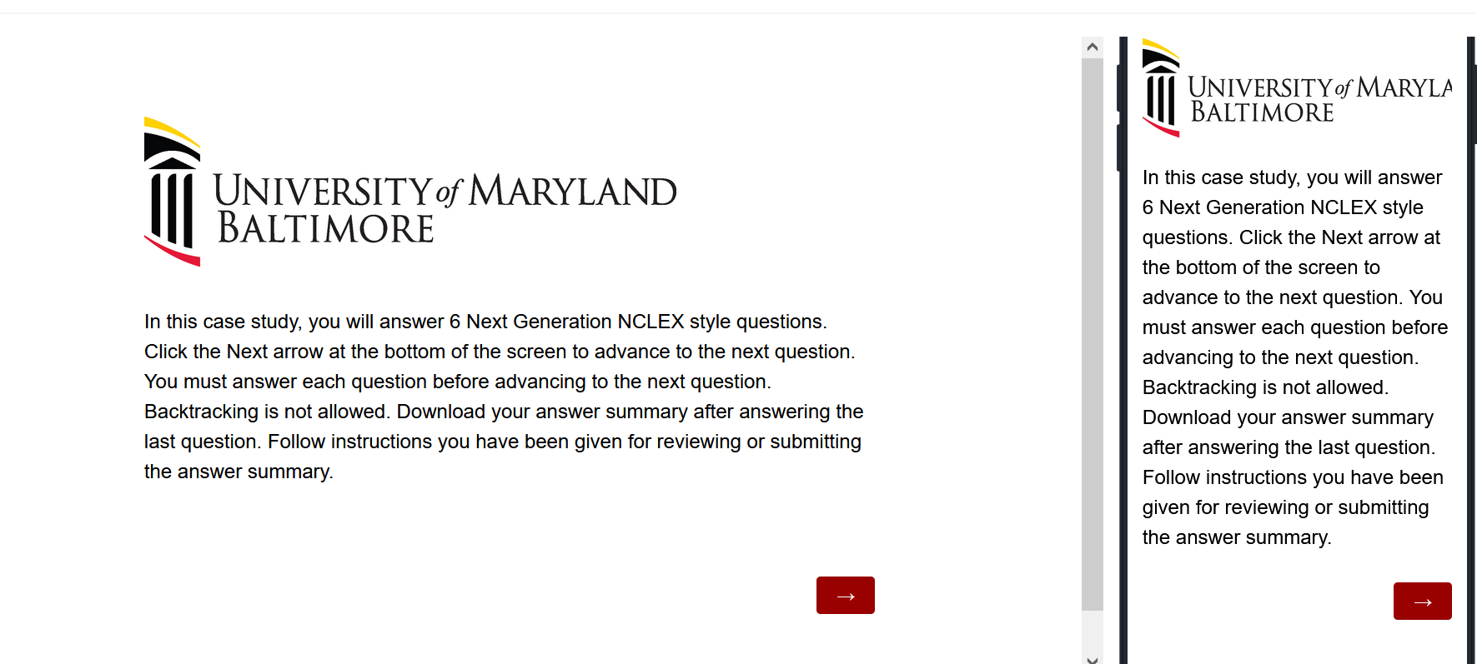
The First Screen Provides Instructions
Use the arrow to advance the screens
There is no backtracking

Slide 15
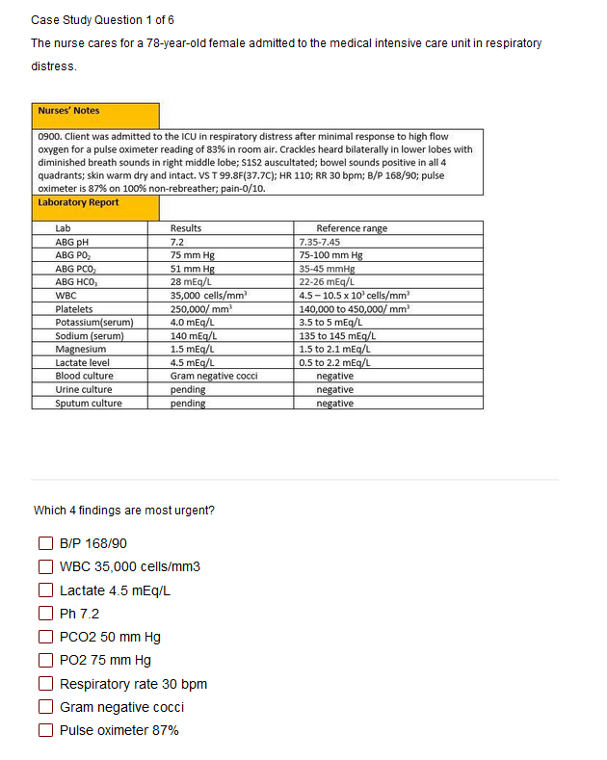

Answer the Questions
Read the instructions carefully.
Sometimes the question tells how many options to pick.
Other times you select all that apply.
Some questions will not allow you to advance if they have not answered enough options.
Use the arrow to advance to the next question if doing a case study

Slide 16
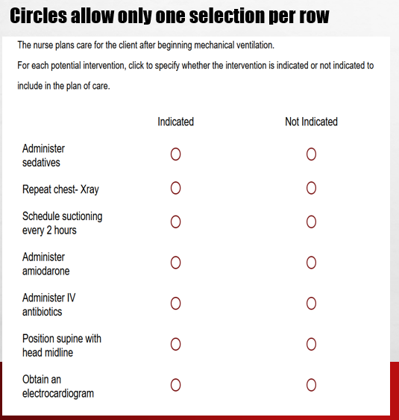
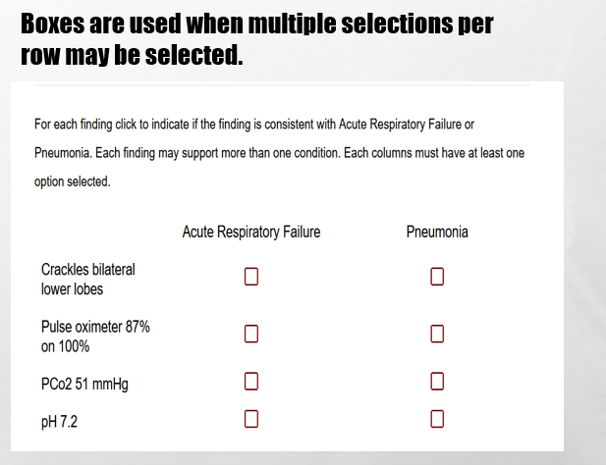
In Tables, Follow Instructions for How Many Options May be Selected in a Row.

Slide 17
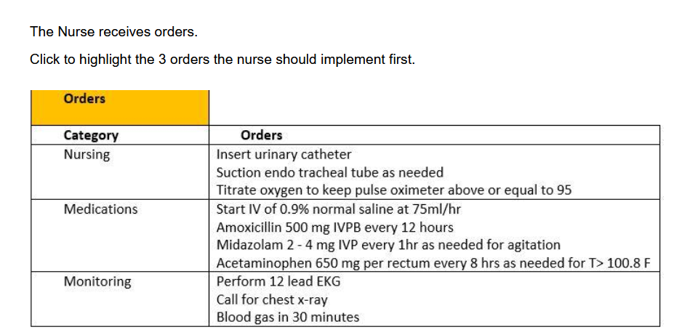
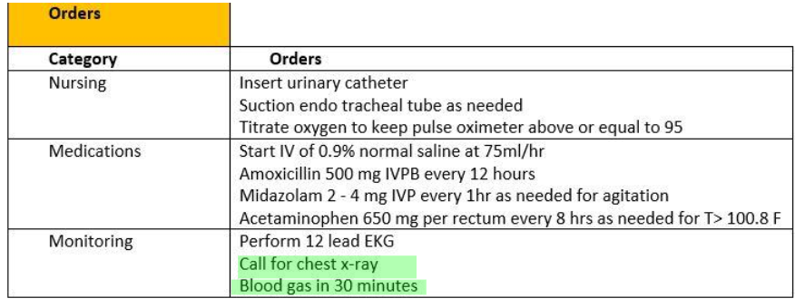
Highlight Questions
Questions first show a plain EMR page
Hovering curser makes boxes appear around selectable data
Click the box to apply the highlight; A second click removes it.

Slide 18
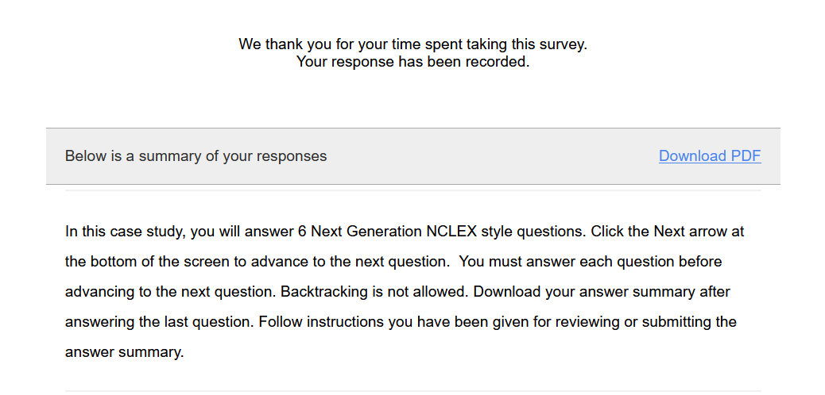
Submit the Final Question and Click Download PDF from Thank You Screen
It is the only way to save your answers.
This step is critical!

Slide 19
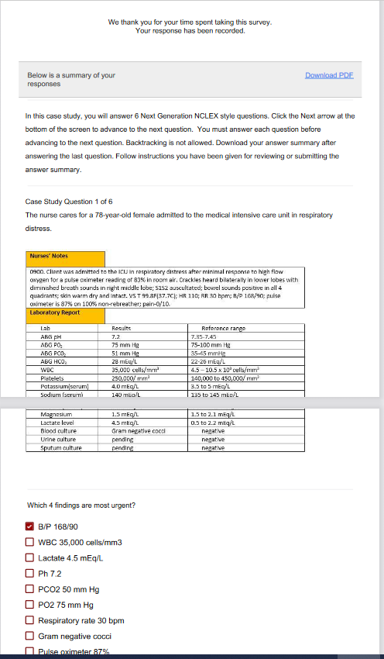
The Response Summary Shows Your Answers
Follow your faculty’s instructions for saving the response summary.
They may have you print it out, save it to computer, or upload it to a learning management system.
The response summary DOES NOT give you the correct answers.
Answers will appear on subsequent slides with information on how to score the item and a rationale for the answer.

Slide 20
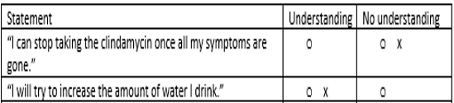
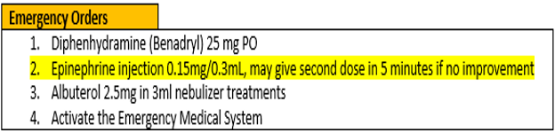
Correct Answers
Correct answers may be indicated 1 of 4 ways
Asterisk appears after correct option*
Option may be underlined with or without an *
Option may appear as an X or * in a table
Correct answer may appear as highlight

Slide 21
New Scoring Rule: +/-
Used when takers may pick unlimited options
Possible points are number of keyed correct items
Earn 1 point for each correct item selected
Loose 1 point for each incorrect item selected
Guessing penalty prevents takers from gaming system by selecting all
Minimum score =0
Which items are viruses? Select all that apply.
■ Chlamydia
■ Influenza[✓]
■ Hepatitis B [✓]
Lyme disease
Pertussis
Tuberculosis
Varicella [✓]
+/- Scoring rule
3 points possible
+2 correct
-1 incorrect
-----------------
1 points

Slide 22
New Scoring Rule: 0/1
Used when takers may select limited options
Possible points are number of keyed correct items
Earn 1 point for each correct item selected
Earn 0 points for incorrect responses
Minimum score 0
Which 3 items are viruses?
■ Chlamydia
■ Influenza[✓]
■ Hepatitis B [✓]
Lyme disease
Pertussis
Tuberculosis
Varicella [✓]
0/1 Scoring rule
3 points possible
+2 correct
-----------------
2 points

Slide 23
Same Answers: Different Scores
Select all that apply
Which 3 items are viruses?
■ Chlamydia
■ Influenza[✓]
■ Hepatitis B [✓]
Lyme disease
Pertussis
Tuberculosis
Varicella [✓]
Which items are viruses? Select all that apply
■ Chlamydia
■ Influenza[✓]
■ Hepatitis B [✓]
Lyme disease
Pertussis
Tuberculosis
Varicella [✓]
0/1 Scoring rule
3 points possible
+2 correct
-----------------
2 points
+/- Scoring rule
3 points possible
+2 correct
-1 incorrect
-----------------
1 point

Slide 24
Rationale Scoring Rule
Complete the sentence from list of dropdown options.
To prevent night blindness the nurse would recommend
because they are rich in vitamin
Used when question has linked concept and a justification in the same sentence
Example: The client most likely has an asthma exacerbation as evidenced by the breath sounds.
Dyad worth 1 point
One cause and one effect
Both parts must be correct for credit
Triad worth 2 points
One cause 2 effects
Cause must be right for any credit
Partial credit given (1 point) if only 1 effect is correct
almonds
carrots✓
orange juice
A
B
C✗
Right condition,
Wrong justification =0 points

Slide 25
Keep track of your score as you move through the review
Case Study | My score | Standalone | My score
Case study 1 |  | Bowtie 1
Case study 2 |  | Trend 1
Case study 3 |  | Bowtie 2
Case study 4 |  | Trend 2
Case study 5 |  | Bowtie 3
 |  | Trend 3
Case Study Total |  | Stand alone Total

Slide 26
Final Link
The final link in the review takes you to the course evaluation.
This anonymous information will be used to help us understand how this review is being used and how to improve the experience.

Slide 27
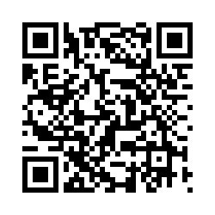
Case Study # 1
URL
QR Code
https://umaryland.az1.qualtrics.com/jfe/form/SV_8cQvohVkmgfi6Wy
Take about 10 minutes

Slide 28
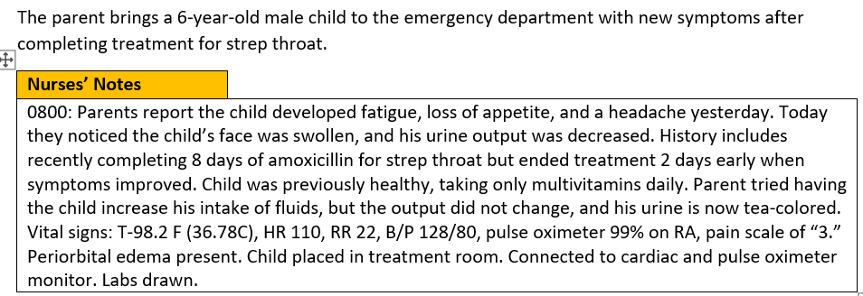
Screen 1 of 6
Drag the 4 findings are most significant to the box on the right
Client Findings
Blood pressure*
Periorbital edema*
Poor appetite
Headache
Fatigue
Urine output*
Increased intake of fluids
History of strep throat*
0/1. This question is worth 4 points.
Give yourself 1 point for each correct response.

Slide 29
Rationale
The blood pressure for an 8- year-old should be less than 120/80. The history of recent strep throat, blood pressure, periorbital edema and changes in urine output are the most significant findings because they suggest the child has poststreptococcal glomerulonephritis. The child is at risk for heart failure, seizures, and encephalopathy due to hypertension and fluid overload as evidenced by bilateral periorbital edema, decreased urine output, hematuria, and high blood pressure of 128/80.

Slide 30
Screen 2 of 6
The nurse suspects poststreptococcal glomerulonephritis and considers the child’s risks.
Which of the following complications is the client at risk for experiencing? Select all that apply
Bowel obstruction
Heart failure*
Diabetes
Liver failure
Fluid overload*
Acute renal failure*
Adrenal insufficiency
Hypertension*
+/-. This question is worth 4 points.
Give yourself 1 point for each correct response
AND subtract 1 point for each incorrect response you selected. The least you can score is 0.

Slide 31
Rationale
The child is at risk for fluid overload leading to hypertension and cardio- pulmonary congestion leading to heart failure. Untreated. The decreased urine output, hematuria, and high blood pressure can lead to renal failure. Gastrointestinal, endocrine, and hepatic complications are not known ramifications of poststreptococcal glomerulonephritis.

Slide 32
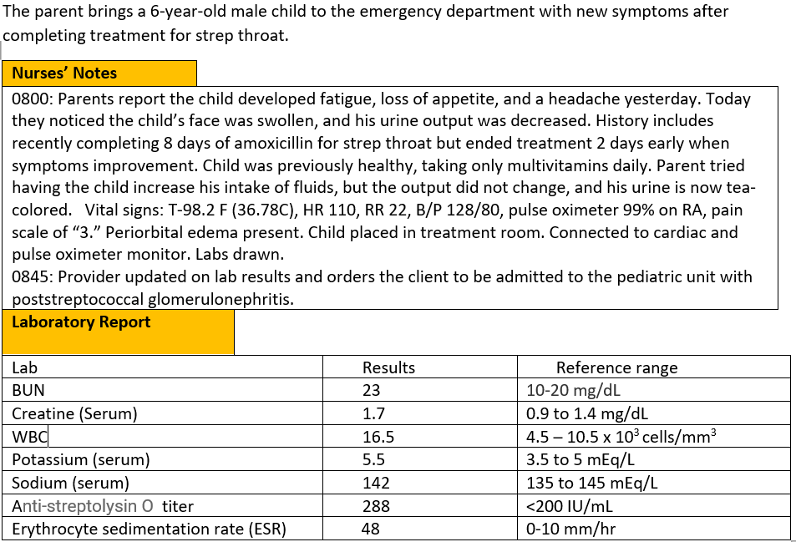
Screen 3 of 6
Labs return and the child receives the diagnosis of poststreptococcal glomerulonephritis.
Complete the sentence from the list of drop-down options.
The problem the nurse needs to address first is | treating the infection lowering the blood pressure managing the fluid overload*
0/1. This question is worth 1 point.
Give yourself 1 point if you answered correctly.

Slide 33
Rationale
The top priority is to manage the fluid overload. Managing the overload will help the blood pressure. The nurse will anticipate orders to treat the infection, however the problem is being caused by an immune response not an infection.

Slide 34
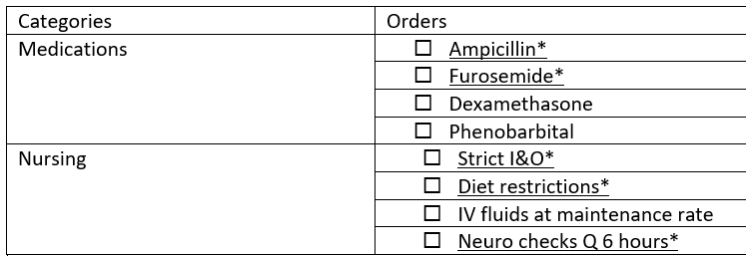
Screen 4 of 6
Select the orders from each of the categories the nurse should anticipate including in the plan of care. Each category may have more than one order.
+/-. This item is worth 5 points- Score each category separately and then add the category scores together.
Score 1 point for each correct answer AND subtract 1point for each incorrect answer. The worst you can score is 0 per category
Medications=2 points
Nursing= 3 points.

Slide 35
Rationale
The top priority is to manage the fluid overload. Managing the overload will help the blood pressure. The nurse will anticipate orders to treat the infection, however the problem is being caused by an immune response not an infection.

Slide 36
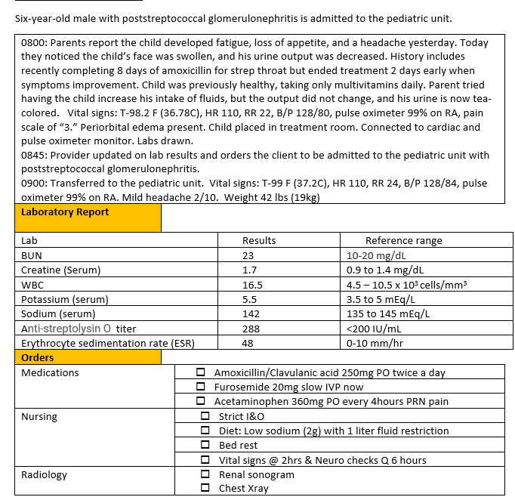
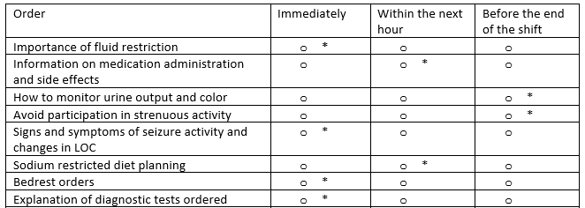
Screen 5 of 6
The The nurse plans the family teaching about the treatment plan.
For each teaching point, click to specify if the nurse should address the teaching immediately upon admission, within the next hour, or before the end of the shift.
0/1. This item is worth 8 points. Give yourself 1 point for every row you got right.

Slide 37
Rationale
When teaching is complex, teaching should be broken down into short segments. Upon admission the things that are most important for the nurse to address before leaving the client alone are the bedrest and fluid restriction orders, signs and symptoms to call the nurse for (in this case seizures or changes in LOC) and diagnostic test that are ordered so the client will not be surprised if another team member comes into the room. Medication teaching should be done when the medicine is given. Diet teaching will need to be done before lunch. Since the client is on bedrest discussions of strenuous activities can occur later. Discussions of monitoring urine output can occur when the child needs to void.

Slide 38
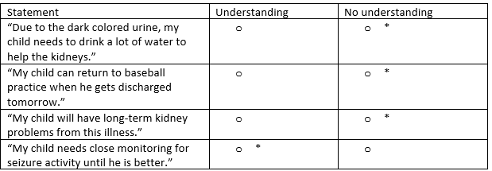
Screen 6 of 6
The nurse evaluates the family’s understanding of the treatment plan.
For each client statement, click to specify whether the statement indicates an understanding, or no understanding of teaching provided.
0/1. This item is worth 4 points. Give yourself 1 point for every row you got right.

Slide 39
Rationale
The child is experiencing poststreptococcal glomerulonephritis. The child is at risk for seizures and encephalopathy. The parent must understand the importance of close monitoring for changes in LOC or seizure activity and when to seek additional medical attention.

Slide 40
Case Study 1 Score
Question | Possible | My score
1 | 4
2 | 4
3 | 1
4 | 5
5 | 8
6 | 4
Total | 26

Slide 41
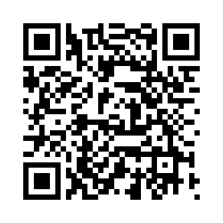
Bowtie # 1
URL
QR Code
https://umaryland.az1.qualtrics.com/jfe/form/SV_3e2Dw5IGoxrIW4m
Take 2-3 minutes

Slide 42
Case Bowtie 1 Score
Question | Possible | My score
Conditions | 1
Actions | 2
Parameters | 2
Total | 5

Slide 43
My Total
Case study | Possible Points | My score | Standalone | Possible Points | My score
Case study 1 | 26 |  | Bowtie 1 | 5
Case study 2 | 25 |  | Trend 1 | 7
Case study 3 | 29 |  | Bowtie 2 | 5
Case study 4 | 30 |  | Trend 2 | 8
Case study 5 | 23 |  | Bowtie 3 | 5
 |  |  | Trend 3 | 1
Case Study Total | 133 |  | Stand alone Total | 31
Total Possible | 164 |  | My score

Slide 44
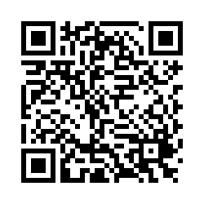
Please Complete the Mini Review Evaluation
https://umaryland.az1.qualtrics.com/jfe/form/SV_1ZYu3gxvlMDziMS
This evaluation will take approximately less than 2 minutes to complete.

